Slide 1

Empowering Users with Self-Service Reporting Solution
…Implementation and Success Story
Presented by: Nkemjika Nwanebu

Slide 2
Agenda
Introduction
Overview of self-service reporting
Adopt the self-service approach to reporting

Slide 3

Overview of Self-service Reporting
National Care Alliance is looking to implement a new self-reporting solution.
Who are the users?
How technical are the users?
What is the best way to engage this user?
How would I approach business readiness?

Slide 4

Addressing Challenges in Accessing Information
Enhances agility and efficiency
Empowers users to make data-driven decisions
Reduces dependency on IT resources

Slide 5
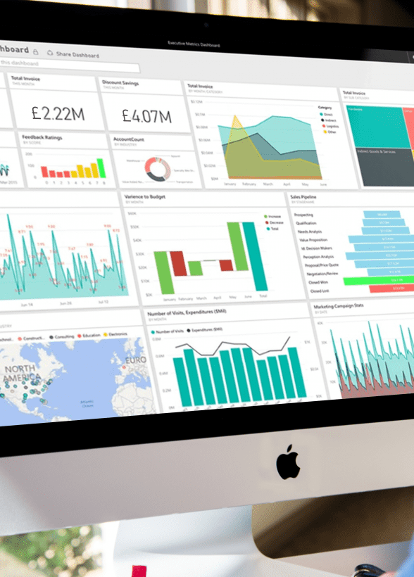
Introduction
Introduction to the concept of self-service reporting.
The importance of empowering users to access information independently.
The organization's commitment to being data-driven.
Notes:
5

Slide 6


Assuming the current situation
Notes:
6

Slide 7



The organization's goal
Successful implementation of self-reporting tool
Notes:
7

Slide 8
Assessing Data Maturity
Evaluate
Evaluate existing data infrastructure
Identify
Identify gaps in data governance and accessibility
Determine
Determine user proficiency with reporting tools

Slide 9

My Role in Self-Service Reporting
Champion the transition to self-service reporting
Collaborate with IT and business units to define requirements
Provide training and support for users
Ensure data integrity and security

Slide 10
My Role in the Adoption Process
My role in facilitating the transition to self-service reporting.
My expertise in data management and analytics.
My responsibility in guiding users through the new reporting platform

Slide 11
Steps to Adopt Self-Service Reporting
Assess Current Reporting Infrastructure
Define User Requirements
Select and Implement Self-Service Reporting Platform
Establish Data Governance Policies
Promote User Adoption

Slide 12
Lessons Learned
What Has Worked Well
What Hasn't Worked Well
Establishing clear communication channels
Providing comprehensive training programs
Fostering a culture of data literacy
Lack of user adoption due to complexity
Insufficient data governance leading to inconsistent reports
Resistance to change from some stakeholders

Slide 13




Implementing Self-Service Reporting
Invest in user-friendly reporting tools
Develop a centralized reporting portal
Establish data governance policies and procedures
Provide ongoing training and support

Slide 14
The Reporting Portal
Central hub for accessing reports and analytics
Customizable dashboards for different user roles
Self-service capabilities for ad-hoc querying and analysis
Integration with existing systems for seamless data flow

Slide 15




Conclusion
Self-service reporting empowers users and enhances organizational agility
Your role is crucial in driving the adoption and success of this approach
By implementing a robust reporting portal and fostering a culture of data literacy, we can unlock the full potential of our data assets.

Slide 16
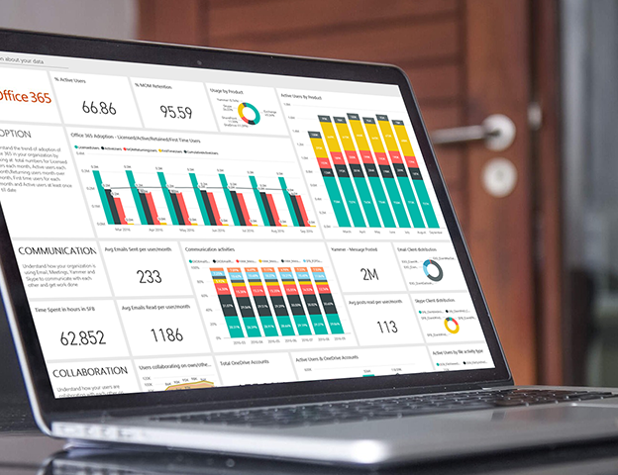
Thank you for having me today
Notes:
16

Slide 17

Question and Answer

